Slide 1
Tobacco
Mr. Lopez and Mr. Guzzarde

Slide 2
Facts about Tobacco
Single puff of tobacco smoke contains more than 4,000 harmful chemicals.
In the U.S. more than 400,000 people die every year from smoking related incidents

Slide 3
What is in tobacco?
Nicotine – an addictive drug found in tobacco
Can cause dizziness, upset stomach, and reduces the amount of oxygen your blood carries to the brain
Tar– a thick, dark liquid that forms when tobacco burns
Tar coats the airways and linings of the lungs
Carbon Monoxide– colorless, odorless, poisonous gas produced when tobacco burns
It damages the brain and heart by reducing the amount of oxygen available to the organs

Slide 4
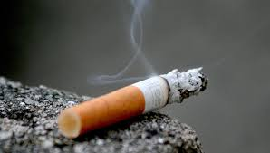
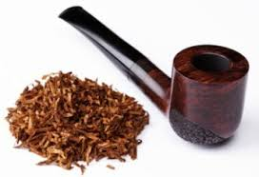
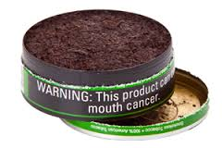
Forms of tobacco
Cigarettes
Cigars
Smokeless
NO TOBACCO BUT CONTAINS NICOTINE

Slide 5
How Tobacco affects YOUR body systems
Respiratory System | Digestive System | Nervous System | Excretory System | Circulatory System
Damages the air-sacs in the lungs called ALVEOLI Too much damage to the alveoli can cause emphysema 22x more likely to develop LUNG CANCER | Gum disease Dulls your taste buds Cancer of the mouth, throat, stomach, and pancreas | Reduces flow of Oxygen to the brain, which can lead to a stroke Strokes can cause permanent brain dysfunction and even death. | Cancer of your organs that help break down unnecessary material Doubles the risk of developing bladder cancer | Heart disease due to TAR* buildup in the major arteries! Smoking also increase heart rate and blood pressure

Slide 6
Video Clip
https://www.youtube.com/watch?v=bHZsvBdUC2I
Straw test!

Slide 7
Tobacco Use and Why Teens Smoke
Peer Pressure
Media makes it look attractive
Wanting to seem more grown up
Wanting to look cool
Parents or other role models smoke
Thinking it will help with weight loss
Addiction!

Slide 8
Tobacco Addiction
Addiction – is a mental or physical need for a drug or other substance
Nicotine is the addictive drug in tobacco
Withdrawal – Unpleasant symptoms that someone experiences when he or she stops using a particular drug they are addicted to.
Psychological Dependence- a persons belief that he or she needs a drug to feel good or function normally
Physical Dependence – an addiction in which the body develops a chemical need for a drug
Quicker in teens because their brains are not fully developed
Tolerance – the body’s need for a larger and larger amounts of a drug to produce the same affect.

Slide 9
Tobacco’s Effects on non-smokers
Secondhand smoke – the air the has been contaminated by tobacco smoke
Passive smokers - are people who are NON SMOKERS who breathe in second hand smoke
Mainstream smoke- the smoke that is inhaled and then exhaled by a smoker
Side stream smoke – smoke that comes from the burning end of a cigarette
Secondhand smoke is filled with nicotine and carbon monoxide, which are known to cause cancer

Slide 10
Rights of nonsmokers
Each year 53,000 people in the U.S die from passive smoking
EVERY PERSON HAS THE RIGHT TO FRESH AIR =)
There are now more laws than ever to restrict smoking in public places
Tobacco companies are required by LAW to put disclaimers on all products

Slide 11
Benefits of being Tobacco Free
Staying healthy
People who smoke get sick easily and stay sick longer
Fresh Breath!
Save MONEY $$$
Better sports performance
Decreases your lung capacity
Clear, healthy, skin
Decreases the amount of oxygen and nutrients that your skin normally uses

Slide 12
How to help someone you know quit smoking
List your personal reasons
Set small goals first!
Choose tobacco free places to spend time
Be physically active
Be consistent

Slide 13
Tobacco Journal #2
Take the next 10 minutes to answer THOUGHTFULLY (4 sentence minimum)
You recently confronted your friend about not smoking around you because of the effects of secondhand smoke. Your friend ignores your request and continues to smoke around you. What would you do next?
If tobacco is so dangerous, why do you think people start smoking? When you see someone else smoking, how does it make you feel?
What legacy do you want to leave behind at Sauganash School? How do you want your peers and teachers to remember you? Are you currently viewed this way?

